Slide 1
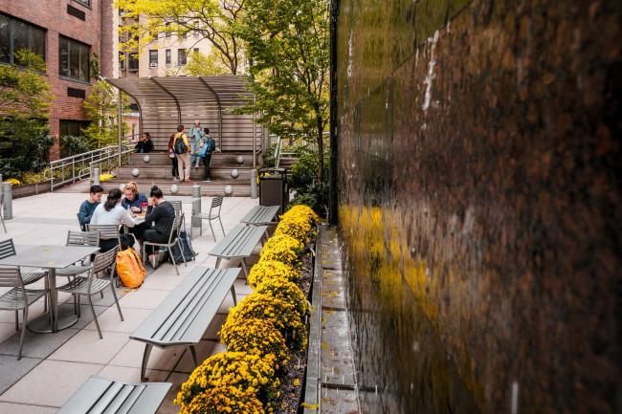
Disability Services
Fall Student Info Sessions
Join us & learn more about:
Using your accommodations
Renewing for next semester
Pursuing accommodations
Documentation process
Wednesday, 9/14:
1:00 pm – 2:00 pm
Focus: Using accommodations
Thursday, 9/15:
1:00 pm - 2:00 pm
Focus: Requesting accommodations
All students are welcome!
If you can’t attend the session with the right focus for your needs, we will still make sure you get your questions answered.
Zoom link: https://marymount.zoom.us/j/92528298078

